Slide 1
http://www.vidyanidhi.com/
ketkiacharya.net@gmail.com
Ketki Acharya
From: SM VITA ATC of CDAC
9769201036
ketkiacharya.net@gmail.com

Slide 2
Data Types and Identifiers

Slide 3
Identifiers
In C#, an identifier is a name assigned to a method, a variable, or any other user-defined item. Identifiers can be one or more characters long.
Variable names may start with any letter of the alphabet or an underscore. Next may be a letter, a digit, or an underscore. ( int 8net = 9-----invalid)
The underscore can be used to enhance the readability of a variable name, as in line_count.
However, identifers containing two consecutive underscores, such as max_ _value, are reserved for use by the compiler.
Uppercase and lowercase are different; that is, to C#, myvar and MyVar are separate names.

Slide 4
How to use reserved keyword as variable
Although you cannot use any of the reserved C# keywords as identifiers, C# does allow you to precede a keyword with an @, allowing it to be a legal identifier.
For example, @for is a valid identifier. In this case, the identifier is actually for and the @ is ignored.

Slide 5
Naming Conventions
All of the names of namespaces, classes, and members in the base classes ,property follow Pascal casing eg.VidyaNidhi
camel casing: calSalary()
Private member
All parameters passed to methods:

Slide 6
Data type
Value Types [Primitive type and struct, enum]
Reference Types[ class, array,string ]

Slide 7
Value Type

Slide 8
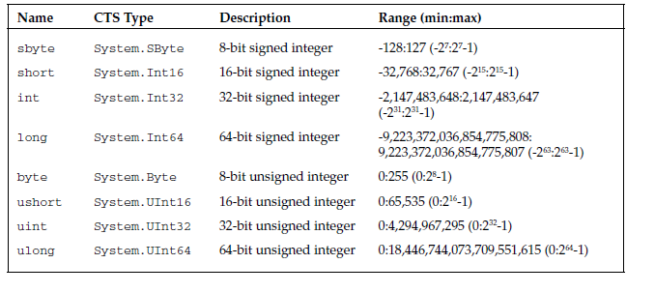
Integer Types

Slide 9
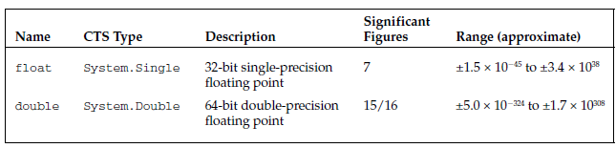
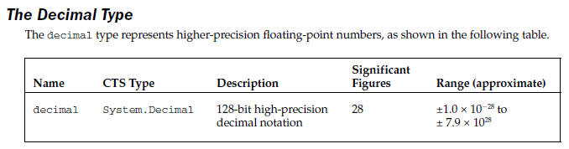
Floating - Point Types

Slide 10

The Boolean Type

Slide 11

The Character Type

Slide 12
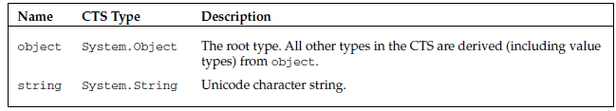
Predefined Reference Types

